Slide 1
IoT Standards and communication Protocols
Presented by
Eng. NIYITEGEKA Janvier
RP/IPRC TUMBA

Slide 2
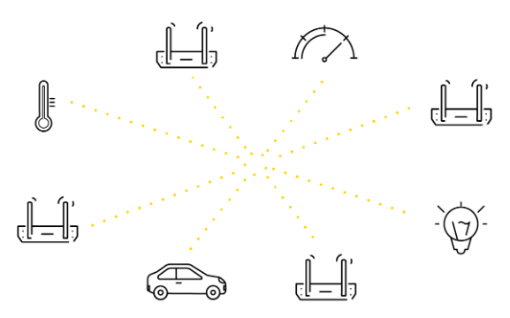
Introduction
Internet of Things encompasses the physical devices.
These devices need to communicate each other.
There are a different communication protocols available at each layer of communication protocol stack.

Slide 3
Introduction
What enables all the smart devices to talk and interact are the IoT protocols which can be seen as languages that the IoT devices use in order to communicate.
This session is an overview of the most popular IoT protocols used on the market to-date.

Slide 4
Cont’d
The devices interaction is only possible when there is a medium of communication, a common ‘language’ that all the devices in a given IoT ecosystem would share and be able to use.
Within the Internet of Things, the medium is provided by the IoT protocols:
either the Internet protocols already long in use, or the IoT protocols especially developed for connected device communication.

Slide 5
Cont’d
Without IoT protocols, hardware would be rendered useless as the IoT protocols enable it to exchange data in a structured and meaningful way.
This is one of the reasons why the Internet of Things needs standardized IoT protocols.

Slide 6
Internet protocol suite
A protocol suite is a collection of protocols that are designed to work together.
The Internet protocol suite is the set of communications protocols used in the Internet and similar computer networks.
It is commonly known as TCP/IP because the foundational protocols in the suite are the Transmission Control Protocol (TCP) and the Internet Protocol (IP).
A protocol is a set of rules that govern how systems communicate. For networking they govern how data is transferred from one system to another.

Slide 7
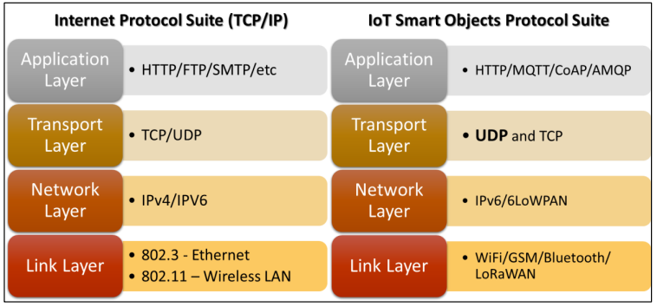
IoT Networking

Slide 8
Layer 1 (Link Layer)
This concerns the infrastructure of the network
IoT infrastructure uses a variety of technologies including:
WiFi
Bluetooth
WiMax
ZIgBee
Cellular
LoRaWAN
IEEE 802.11ah, RFID
SigFox
NB-IoT
Weightless

Slide 9
1. IEEE 802.15.4
IEEE 802.15.4 is the most commonly used IoT standard for MAC.
It defines a frame format, headers including source and destination addresses, and how nodes can communicate with each other.
In 2008, IEEE802.15.4e was created to extend IEEE802.15.4 and support low power communication and meet IoT communications requirements.

Slide 10
2. IEEE 802.11 AH
IEEE 802.11ah is a low-energy version of the original IEEE 802.11 wireless standard used by WiFi. IEEE 802.11 standards (also known as Wi-Fi) are the most commonly used wireless standards.
The original WiFi standards are not suitable for IoT applications due to their frame overhead and power consumption.
IEEE 802.11ah operates in the sub-gigahertz band (900 MHz). Because of the relatively lower frequency, the range is longer since higher frequency waves suffer from higher attenuation.

Slide 11
3. Bluetooth
Bluetooth is a short-lange wireless technology standard for exchanging data over short distances with frequency band from 2.4 to 2.485 GHz.
If you look at the frequencies it is actually the same as WiFi such that these two technologies seem very similar.
can have a data rate up to 3 Mbps and range from 10m and the maximum depends on manufacturer

Slide 12
4. Bluetooth Low Energy
Bluetooth low energy or Bluetooth smart is a short range communication protocol
Its low energy can reach ten times less than the classic Bluetooth while its latency can reach 15 times.
It follows master/slave architecture and offers two types of frames: adverting and data frames.

Slide 13
5. Zigbee.
It is based on the IEEE 802.15.4 communication protocol standard and is used for personal area networks or PANs .
The Zigbee standard operates on the IEEE 802.15.4 physical radio specification and operates in unlicensed bands including 2.4 GHz, 900 MHz and 868 MHz. The date rate of 250 kbps is best suited
The range of Zigbee device communication is very small (10–100 meters).
There are three types of devices in a Zigbee network: FFD (Fully Functional Device), RFD (Reduced Functional Device), and one Zigbee coordinator. A FFD node can additionally act as a router.

Slide 14
Zigbee Architecture
Zigbee system structure consists of three different types of devices such as Zigbee coordinator, Router and End device.
Every Zigbee network must consist of at least one coordinator which acts as a root and bridge of the network.
The coordinator is responsible for handling and storing the information while performing receiving and transmitting data operations.
Zigbee routers act as intermediary devices that permit data to pass to and fro through them to other devices.
End devices have limited functionality to communicate with the parent nodes such that the battery power is saved

Slide 15
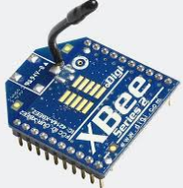
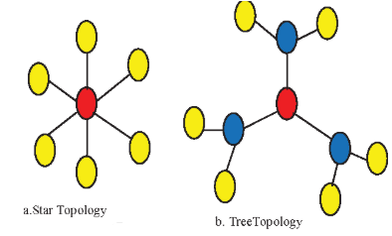
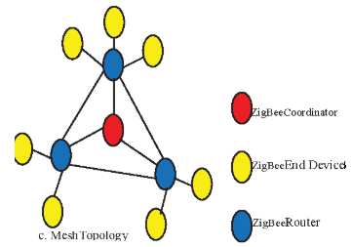
ZigBee Connection Topology

Slide 16
6. LTE-A
Long-Term Evolution Advanced (LTE-A) is a set of standards designed to fit M2M communication and IoT applications in cellular networks.
LTE-A is a scalable, lower- cost protocol compared to other cellular protocols.

Slide 17
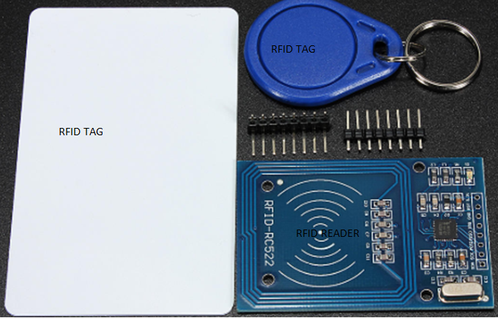
7. RFID

Slide 18
Cont’d
Radio frequency identification (RFID) is the wireless use of electromagnetic fields to identify objects.
RFID tag is also attached to an inventory such that its production and manufacturing progress can be tracked through the assembly line.
Usually you would install an active reader, or reading tags that contain a stored information mostly authentication replies.
Short range RFID is about 10cm, but long range can go up to 200m.

Slide 19
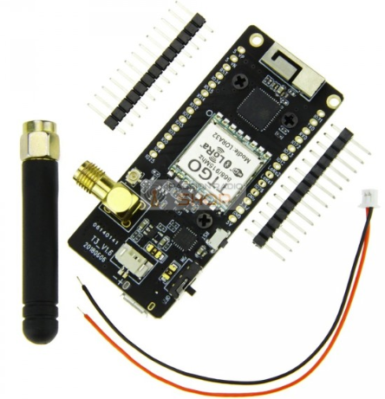
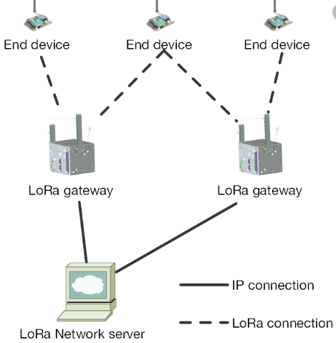
8. LoRaWAN

Slide 20
Cont’d
LoRaWAN is a newly arising wireless technology designed for low-power WAN networks with low cost, mobility, security, and bi- directional communication for IoT applications.
It is a low power consumption optimized protocol designed for scalable wireless networks with millions of devices.

Slide 21
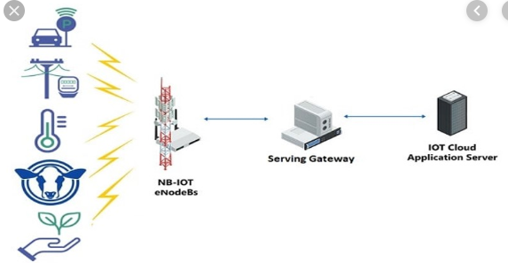
9. Narrow band IoT

Slide 22
10. NB-IoT cont’d
Narrowband IoT (NB‑IoT), also known as LTE Cat NB1, is a Low Power Wide Area (LPWA) technology .
It connects devices more simply and efficiently on already established mobile networks, and handles small amounts of data, securely and reliably.
This protocol can be deployed into existing cellular network architecture.
It is promised that this technology will be included in 5G cellular technology

Slide 23
Cont’d
It is optimized for applications that need to communicate small amounts of data over long periods of time.
Since it operates in licensed spectrum, it is secure and reliable providing guaranteed quality of service.

Slide 24
11. Neul
This protocol operates in the sub-1 GHz band.
It uses small chunks of the TV whitespace spectrum to create low cost and low power networks with very high scalability.
It has a 10km range and uses the Weightless protocol for communication.

Slide 25
Layer 2 &3: Network and Transport Layer
Look at the communication protocols which includes routing (choosing optimal path) and providing reliability (retransmission).
IPv6- is the upgraded version of IPv4, which could not cope with boom of ip addresses demand. It also has other features such as encryption and simple header (less overhead).
6LoWPAN-is the acronym of IPv6 over Low power Wireless Personal Area Networks implemented for increasing the range of local area network. It is an adaption layer for IPv6 over IEEE802.15.4 links. This protocol operates only in the 2.4 GHz frequency range with 250 kbps transfer rate.
UDP-(User Datagram Protocol) is used an as alternative to TCP (reliable delivery), that provides performance tuned for real-time applications.

Slide 26
6LoWPAN
It efficiently encapsulates IPv6 long headers in IEEE802.15.4 small packets, which cannot exceed 128 bytes.
The standard provides header compression to reduce transmission overhead, fragmentation to meet the 128-byte maximum frame length in IEEE802.15.4.

Slide 27
Layer 4 (Application Layer)
Application layer interacts with an application program, which is the highest level.
The application layer is the layer, which is closest to the end-user. It means the application layer allows users to interact with other software application.
This layer is predominated with different protocols that include:
HTTP, MQTT, CoAP, AMQP,SMQTT

Slide 28
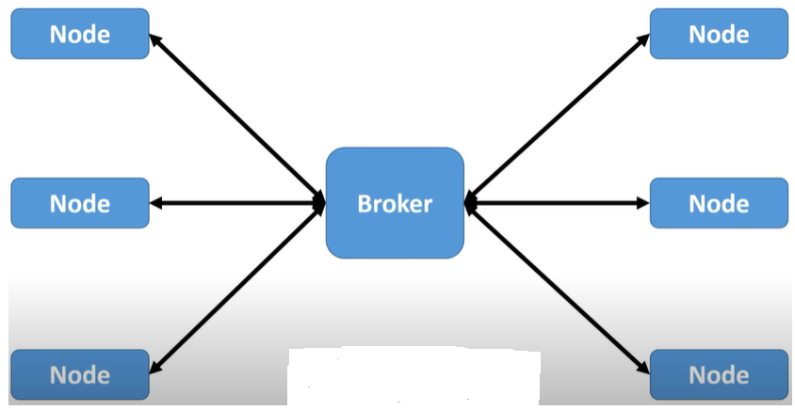
1. MQTT Protocol

Slide 29
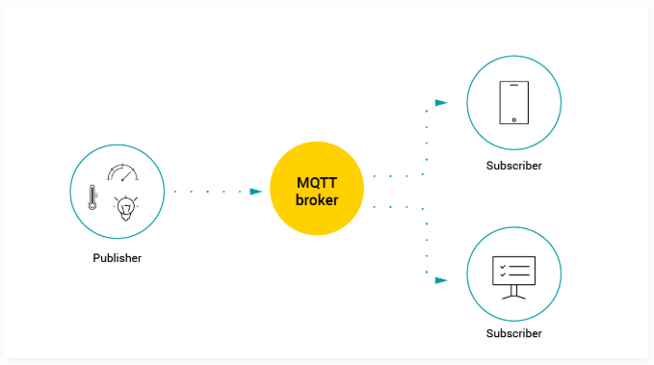
MQTT Protocol

Slide 30
MQTT cont’d
MQTT is a publish-subscribe protocol that facilitates one/many-to-many communication between clients through a central broker.
Clients can publish messages to a broker and/or subscribe to a broker to receive certain messages.
From IoT point of view, publishers are basically the lightweight sensors that connect to the broker to send their data and go back to sleep whenever possible.

Slide 31
MQTT Cont’d
Subscribers are applications that are interested in a certain topic, or sensory data, so they connect to brokers to be informed whenever new data are received.
The brokers classify sensory data in topics and send them to subscribers interested in the topics.

Slide 32
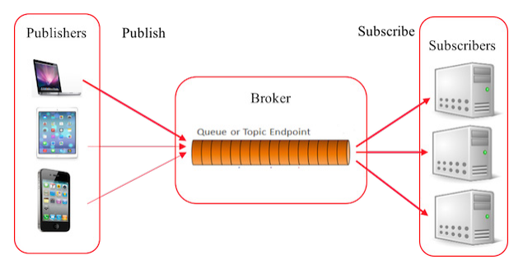
MQTT Architecture

Slide 33
Cont’d
Designed for battery-powered devices, MQTT’s architecture is simple and lightweight, providing low power consumption for devices. Working on top of TCP/IP protocol,
The role of the broker, on the other hand, is to ensure security by cross-checking the authorization of publishers and subscribers.

Slide 34
Quality of Service modes of MQTT
QoS0 (At most once): The least reliable mode but also the fastest. The publication is sent but confirmation is not received.
QoS1 (At least once): Ensures that the message is delivered at least once, but duplicates may be received.
QoS2 (Exactly once): The most reliable mode while the most bandwidth-consuming. Duplicates are controlled to ensure that the message is delivered only once.

Slide 35
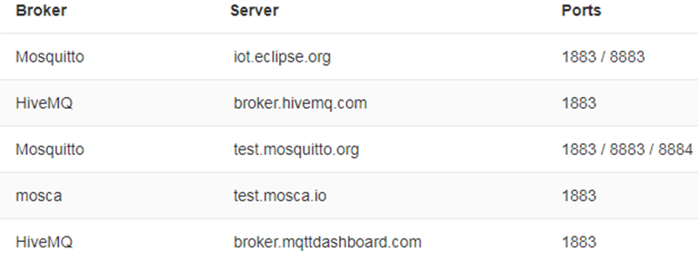
Types of Brokers

Slide 36
2. SMQTT
An Secure MQTT (SMQTT) uses encryption. The main advantage of using such encryption is that the message is encrypted before being sent.
In general, the algorithm consists of four main stages: setup, encryption, publish and decryption.
In the setup phase, the subscribers and publishers register themselves to the broker and get a master the same secret key.
Then the data is encrypted, published to the broker which in turn sends it to the subscribers and finally decrypted at the subscribers which have the same master secret key.

Slide 37
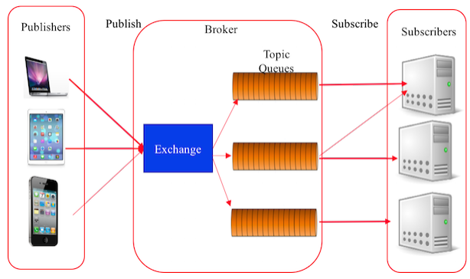
3. AMQP

Slide 38
AMQP cont’d
The Advanced Message Queuing Protocol (AMQP) is another session layer protocol that was designed for financial industry.
It runs over TCP and provides a publish/ subscribe architecture which is similar to that of MQTT.
The difference is that the broker is divided into two main components: exchange and queues

Slide 39
AMQP Cont’d
The exchange is responsible for receiving publisher messages and distributing them to queues based on pre-defined roles and conditions.
Queues basically represent the topics and subscribed by subscribers which will get the sensory data whenever they are available in the queue

Slide 40
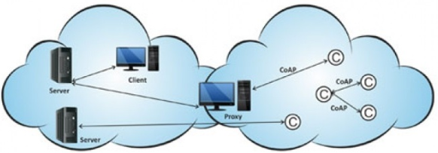
4. CoAP Protocol

Slide 41
CoAP Protocol
Constrained Application Protocol (CoAP), is a client-server protocol.
CoAP is, primarily, a one-to-one protocol for transferring information between client and server.
Constrained Application Protocol (CoAP) was designed to provide an interface between HTTP clients and Servers.

Slide 42
CoAP
The constrained Application Protocol(CoAP) is a specialized web transfer protocol for use with constrained nodes(small devices) and constrained networks in the Internet of Things.
CoAP is a protocol which can transport RESTful calls over "thin" networks

Slide 43
CoAP Cont’d
It is also adapted to small resources of IoT devices
Only needs small memories and slow processors for the needs
Uses more efficient UDP protocol
Communication goes directly from a client to s server, no intermediate necessary, exactly like a webservices

Slide 44
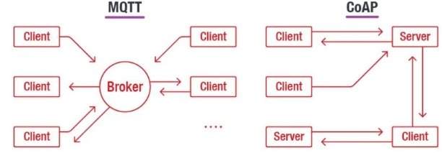
Difference between MQTT and CoAP

Slide 45
5. XMPP
Extensible Messaging and Presence Protocol (XMPP) is a messaging protocol that was designed originally for chatting and message exchange applications.

Slide 46
References
https://www.avsystem.com/blog/iot-protocols-and-standards/
Nijas2012.home.blog
https://www.cse.wustl.edu/~jain/cse570-15/ftp/iot_prot.pdf
https://www.networkworld.com/article/3142778/internet-of-things-messaging-part-1-introducing-mqtt.html

Slide 47


